Slide 1




New York Taxi Cab Commission
Alfred D. Hull

Slide 2
Table of Contents
Phase I. Business Understanding
Project Flow - Business
Project Flow - Details
Phase II. Data Understanding
Phase III. Data Preparation
Phase IV. Modeling
Phase V. Evaluation
Phase VI. Deployment Iteration I

Slide 3

Phase I.
Business Understanding

Slide 4
Project Flow
Problem
Solution
Wasted Time
Search
Faster search and analytics
Business
Data Stored in multiple .csv
Engineer Data Pipeline to consoldate
Data

Slide 5
Project Flow - Details
Problem
Solution
Analysts spend countless hours retrieving .csv files.
Due to an abundance of available trip data analysts may get confused and churn.
Reduce search time by feeding analysts data that is consolidated and streamlined for their analytics needs.
Business
New York Taxicab Commission historical data.
Understand how the archived files are stored.
Pull files down and transform them into an easier searchable format like parquet.
Data

Slide 6
Phase II.
Data Understanding

Slide 7

The historical load comprises the below-archived file sets for each month of the year since 2009, totaling around 288 gigabytes. The complementary delta loads occur each month and increment the data set by at least 2 gigabytes in total.
Delta Load (2 gigabytes per month):
Yellow Taxi Trip Records (CSV): file size – 579,698 KB
Green Taxi Trip Records (CSV): file size – 39,744 KB
For-Hire Vehicle Trip Records (CSV) – 108,186 KB
High Volume For-Hire Vehicle Trip Records (CSV) – 1,273,342 KB
Historical Load (288 gigabytes):
Yellow Taxi Trip Records (CSV): file size – 83,476,512 KB
Green Taxi Trip Records (CSV): file size – 5,723,136 KB
For-Hire Vehicle Trip Records (CSV) – 15,578,784 KB
High Volume For-Hire Vehicle Trip Records (CSV) – 183,361,248 KB

Slide 8
Phase III.
Data Preparation

Slide 9
Data preparation
Historical Trip data
Data Pipeline
The goal here is to understand what the analyst needs then assess the current state and build an operational approach.
Parquet files

Slide 10
Phase IV.
Modeling

Slide 11
Machine Learning
Python
As the data in the use-case here is extremely big it is important to leverage the cloud for both comput and storage.
Virtual Machines

Slide 12
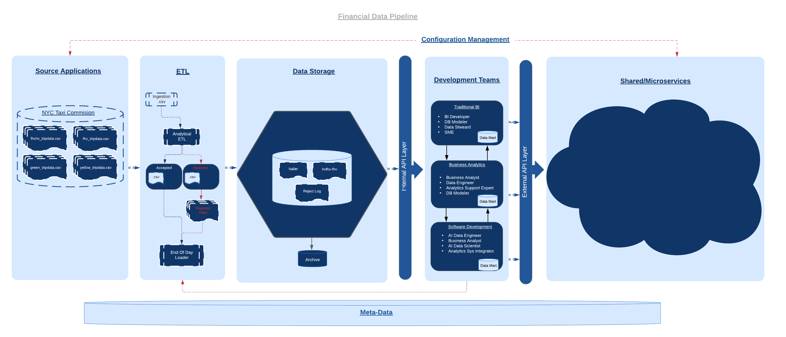

Data Pipeline

Slide 13
Phase VI.
Evaluation

Slide 14
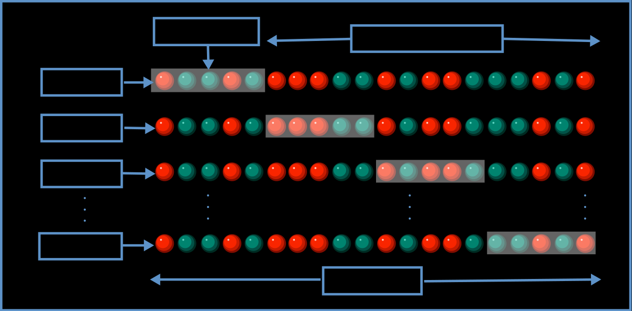
Evaluation
After building the data pipeline and pushing writing the files to a more accommodating format like parquet the data science team sees close to a significant decrease in the time, they spend wrangling data. The time given back to them is then applied to increase model accuracies and performance for cross validation efforts they were not able to conduct before.
They can also consider a few more factors and methods to evaluate the model and improve the performance of our model.
Cross Validation
Even after cross-validating their models to ensure no bias was encountered they can see that the model’s accuracy across five separate (K-Folds) was still on average about 90%.
This shows that the model is in fact performing quite well and that the time we have given them back due to our data engineering efforts have paid off.

Slide 15
Phase VI.
Deployment Iteration I.

Slide 16
Conclusion
System Surveillance
Data Collection
Results
Set monitoring activities to collect and house data.
Trip Data captured during normal operations.
The best way to enhance analysts experience is by reducing the time spent on data engineering and wrangling activities. The effort in this case is a simple pipeline aiming to provide the most relevant information to analysts by transforming the information into a scalable format for big data analysis.
Trip Data
Machine Learning
Iterative monitoring database
Time given back is then applied to optimize and find new ways to deliver value.

Slide 17
Looking Forward
Increase Number
Of Features
Data Capture
Proactive Monitoring
The historical method of data storage is not scalable as the data has grown too large for any individual to analyze on the company issues equipment. | Currently the system captures data and houses it for academic training purposes. | Currently the use-case here while academic in nature is static.
As the Data Engineering effort ramps up It may be beneficial to select other ridership features for instance demographic information and or regional information such as taste and locale. | It may be beneficial to invest in a cloud database i.e. Azure Cosmos DB so that trip data can be added to via crowd sourced and employ a team of Data Stewards to ensure ETL processes clean the data to be stored in academic data marts. | It is critical that information like this gets out as it has far reached implications to foster and environment of inclusion and diverse thought. For instance, building a storage container and establishing an API will allow more analysts and data scientists to find ways at improving process for NYC.
Current
Future

